Slide 1


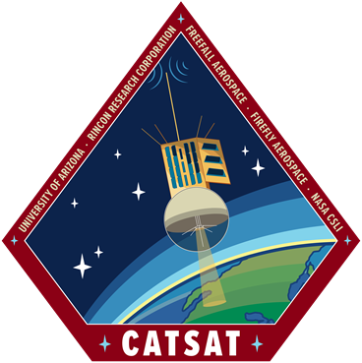
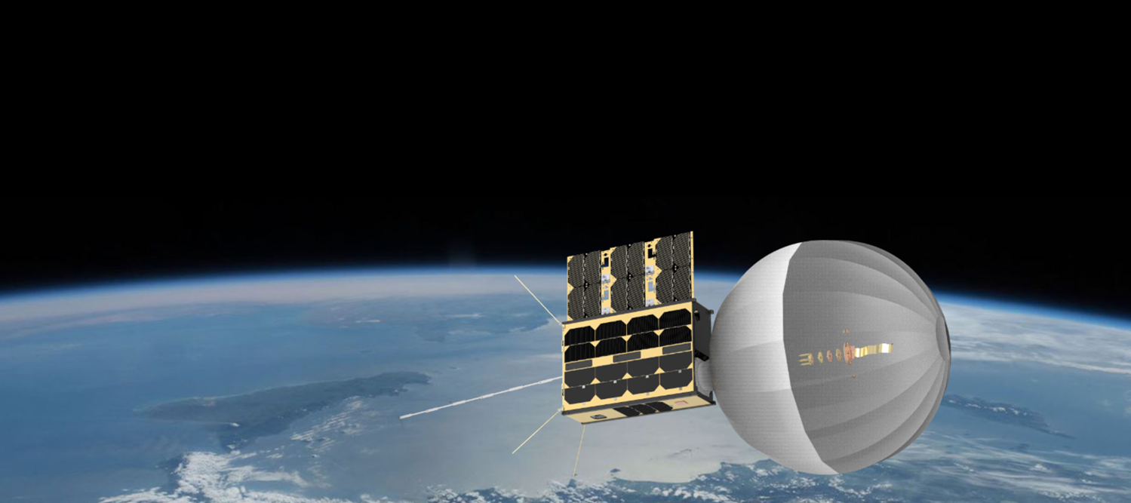


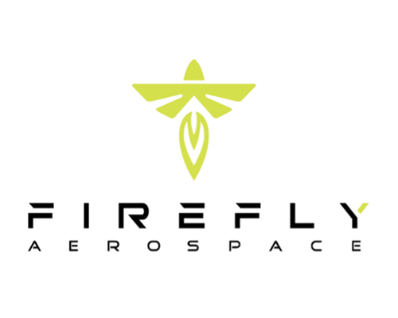

CatSat: Satellite Flight Hardware and
Ground Station Assembly
Shae Henley, mentored by Dr. Christopher Walker
University of Arizona
2023 Arizona NASA Space Grant Statewide Symposium, April 22nd, 2023

Slide 2
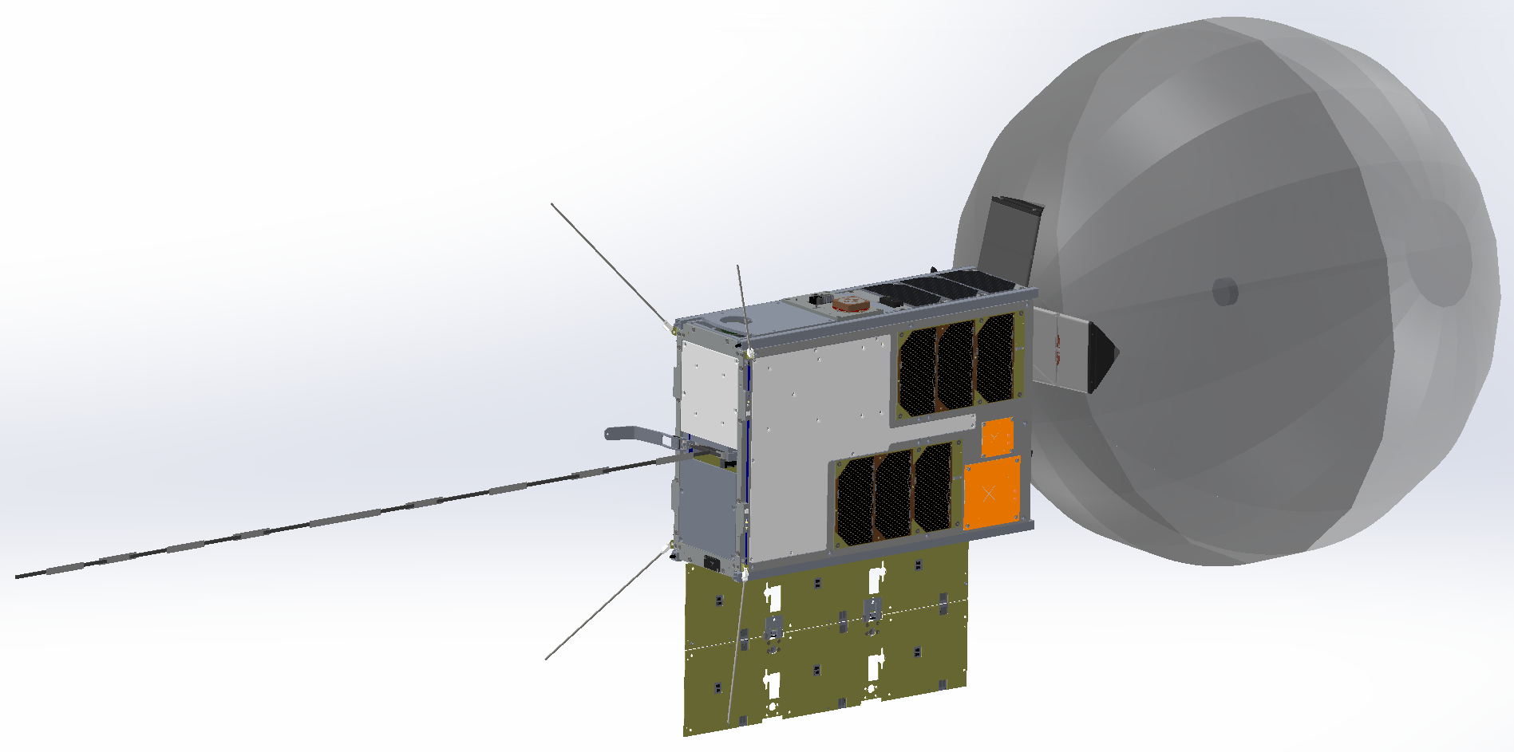
Antenna Technologies & Ionospheric Research
CatSat’s research goals are to enhance small satellite communications and study the Earth’s ionosphere.
Inflatable Antenna:
Satellite communications are limited to the size of their antennas; CatSat’s solution is the inflatable antenna
WSPR Antenna:
Used to probe variations and measure diurnal changes in the ionosphere
HD Camera
Inflatable Antenna
UHF Antenna
10 GHz Patch Antenna
WSPR Antenna
5 GHz Patch Antenna

Slide 3
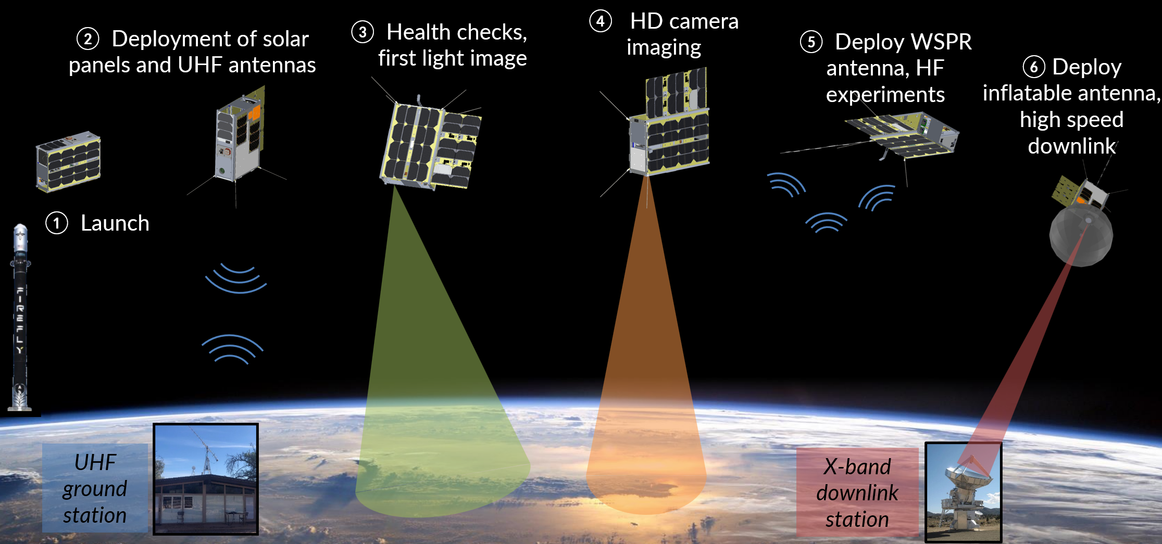
CatSat’s Concept of Operations
① Launch
223

Slide 4
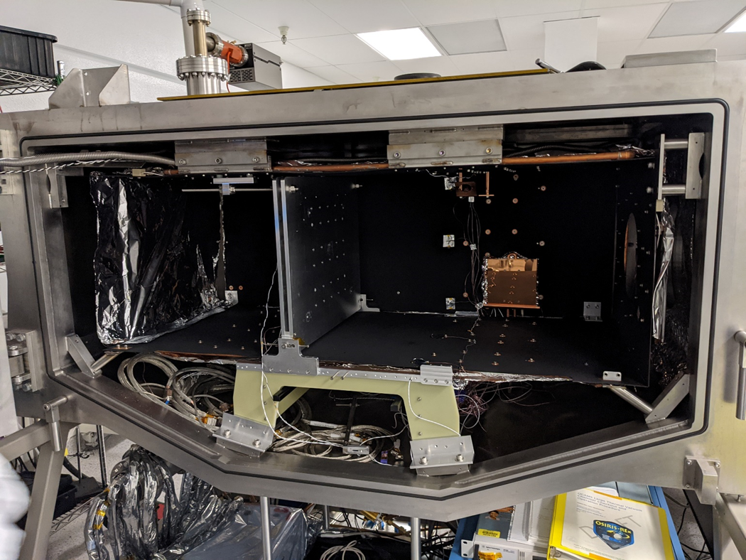
Functional and Environmental Satellite Testing
The satellite must survive launch and function in low-Earth orbit (LEO); CatSat will be orbiting at approximately 565 km.
.
Functional Testing
Deployment Testing (IADS, WSPR)
System Functionality
Environmental Testing
Thermal Vacuum Testing
Thermal Cycle Tests
Thermal Vacuum Cycle Tests
Random Vibration Testing
TVAC chamber at Drake Building (2021)

Slide 5
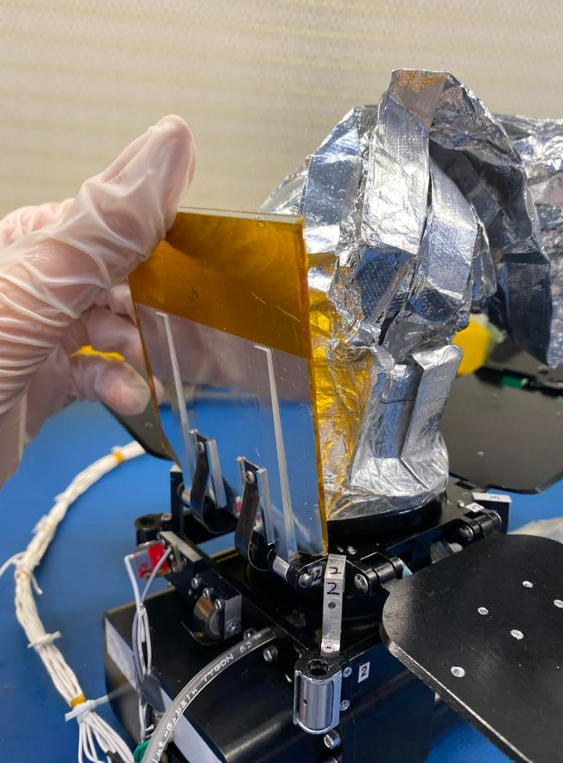
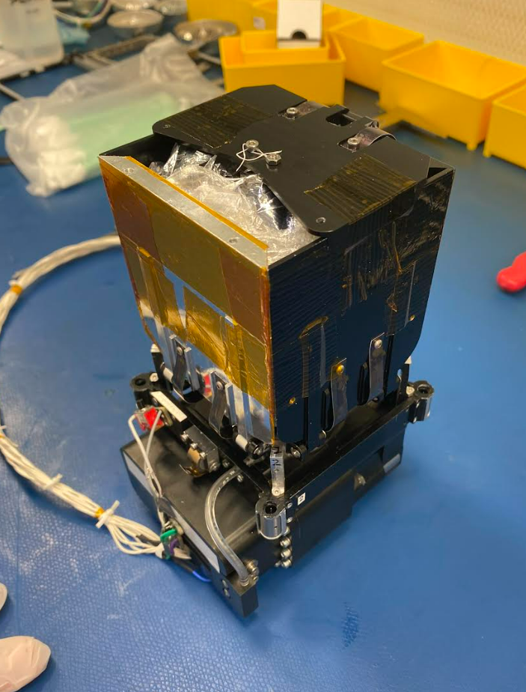
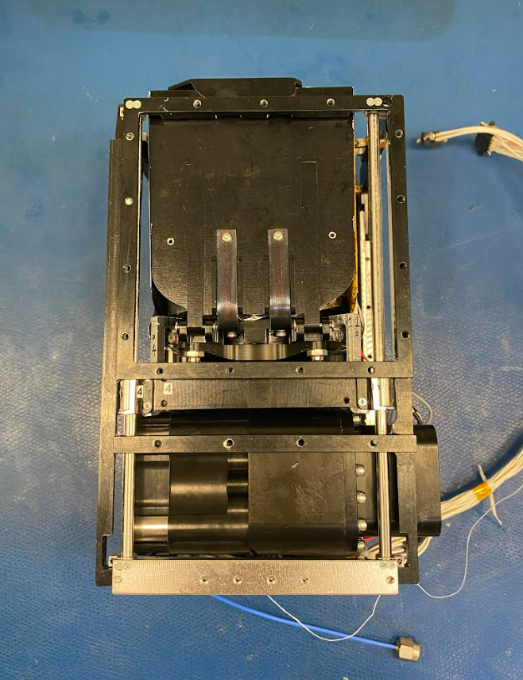
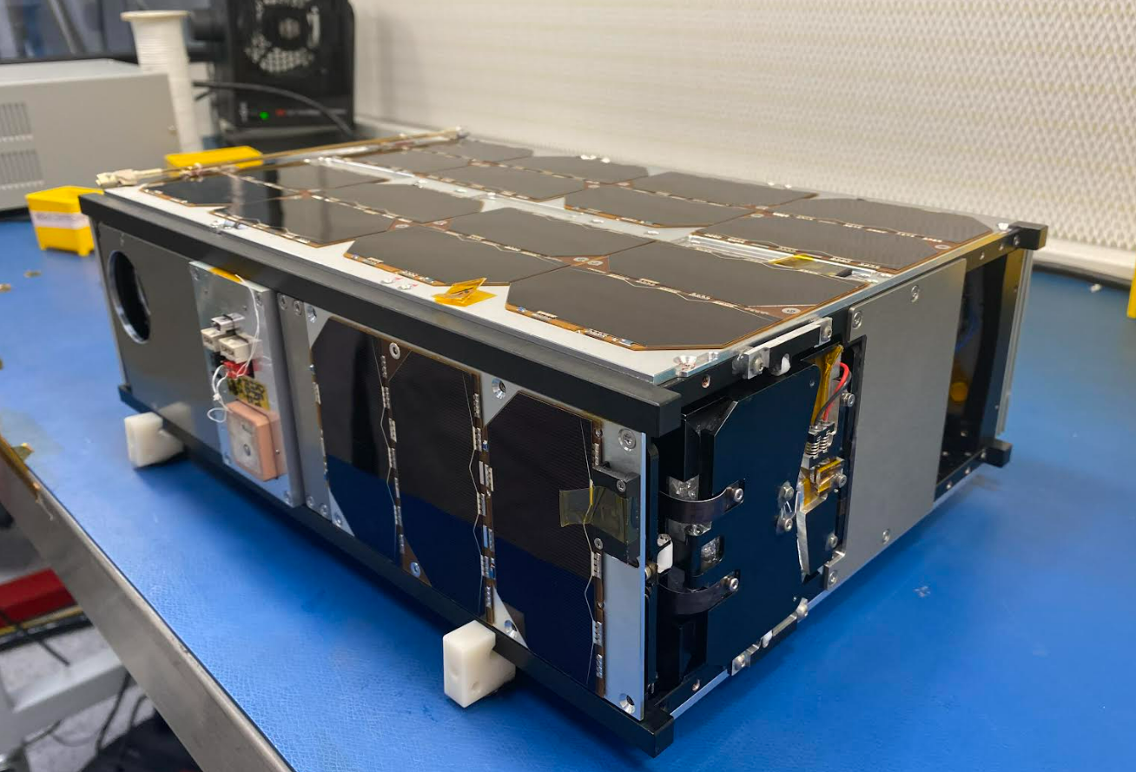
Inflatable Antenna
The new communication technology CatSat will be testing; the antenna has high bandwidth, low mass, and low predeployment volume
CatSat will be the first space flight demonstration of this technology
Up to 50 Mbps data link from LEO with a 0.5m antenna
CubeSat Packaging
Mylar Membrane
Trapdoors
Gas Canisters
System Chassis
Top of IADS Compartment

Slide 6
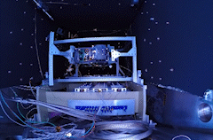
Inflatable Antenna Deployment
Deployment of the final inflatable antenna design in the TVAC chamber, under simulated space conditions

Slide 7
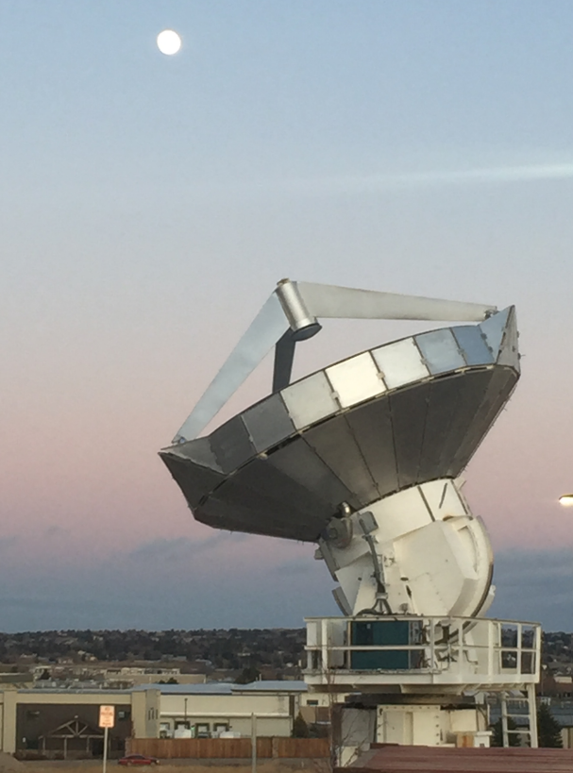
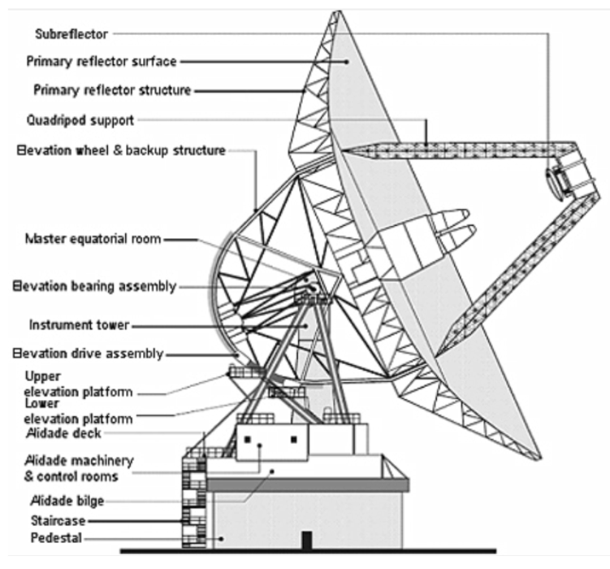
Biosphere 2’s 6.1m Radio Antenna
There are several ground stations set up to communicate with and control CatSat once in orbit; we are also establishing a UHF ground station for command and control at the University of Arizona
Developing X-band optics for the Biosphere 2 10 GHz downlink station, and designing a plano-convex lens
Incoming CatSat signals
Focusing toward the subreflector
Redirection towards processing
MDSCC (2011)
Hyatt et al. (2020)

Slide 8
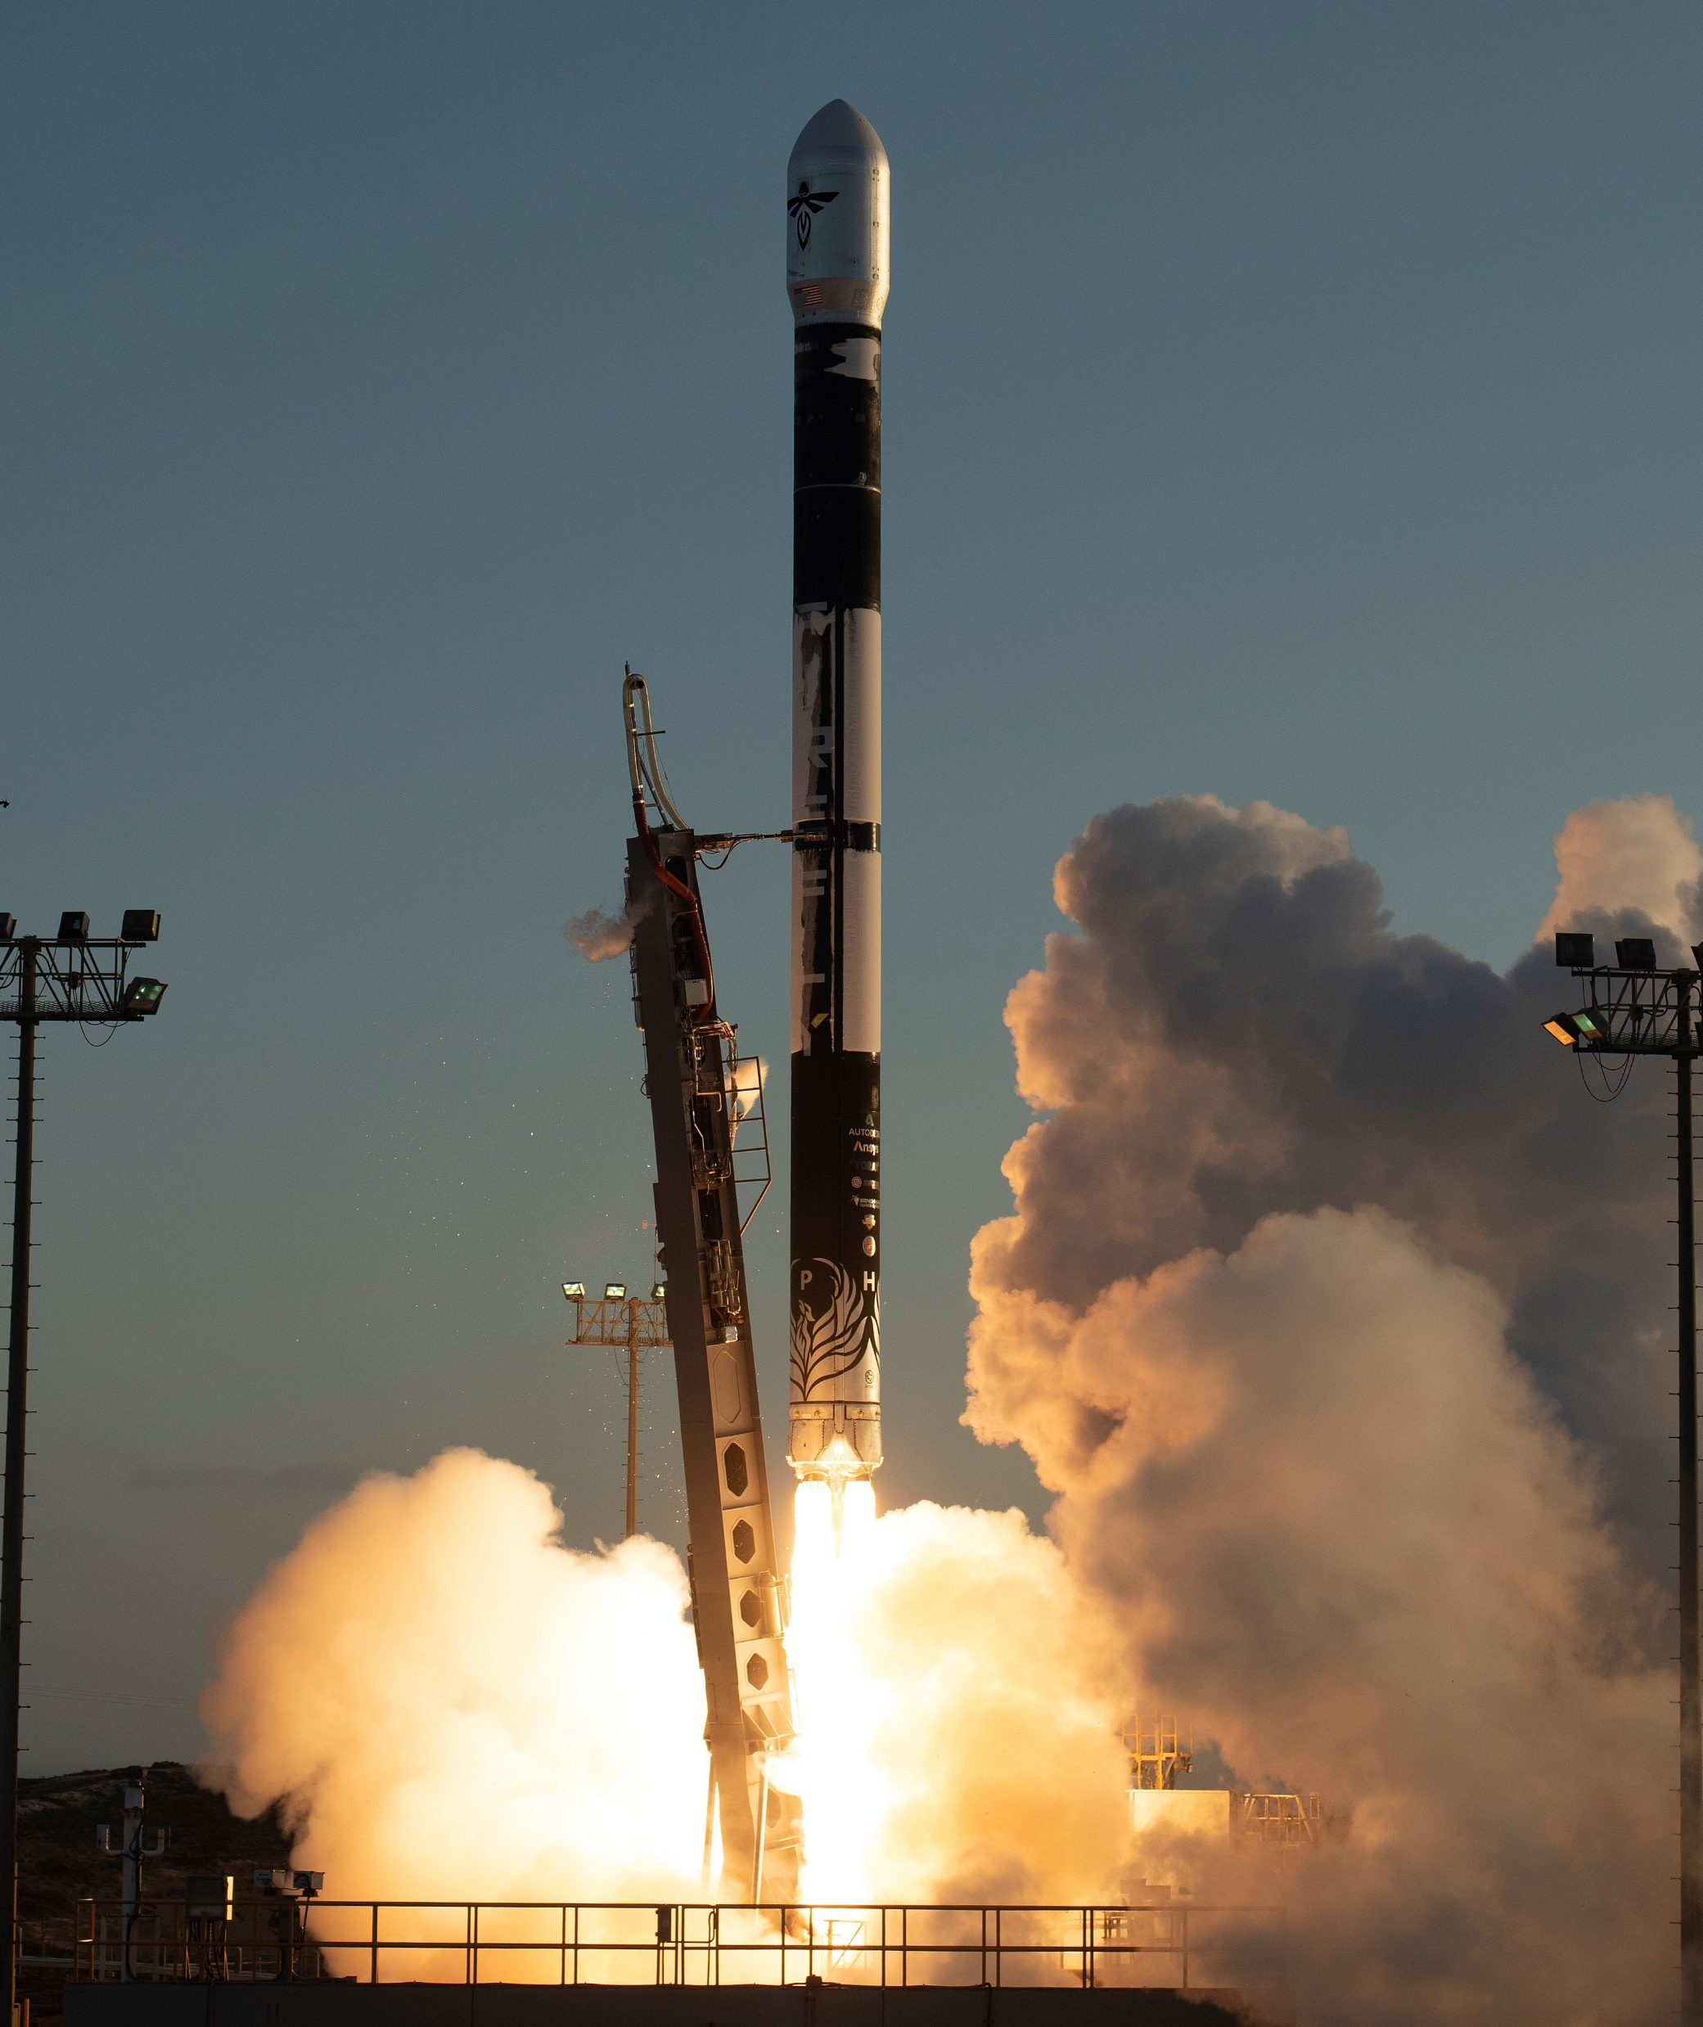
Significance and Future Impact
The development of CatSat hardware and successful completion of functional and environmental tests have ensured these technologies are ready to launch, function as expected in LEO, and last the lifespan of the CubeSat.
Data from the ionospheric HF experiments will be made publicly available.
The deployment of the inflatable antenna in space will demonstrate the effectiveness of the new antenna technology, as well as show its potential for future missions.
Firefly Aerospace’s Alpha Rocket (2021)

Slide 9
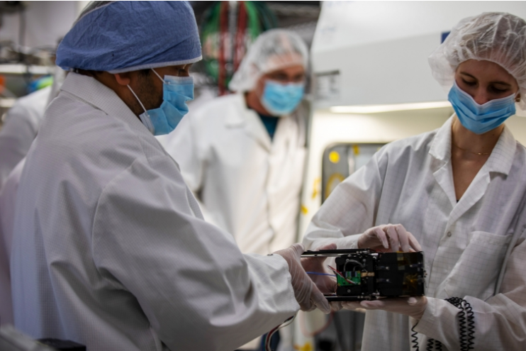
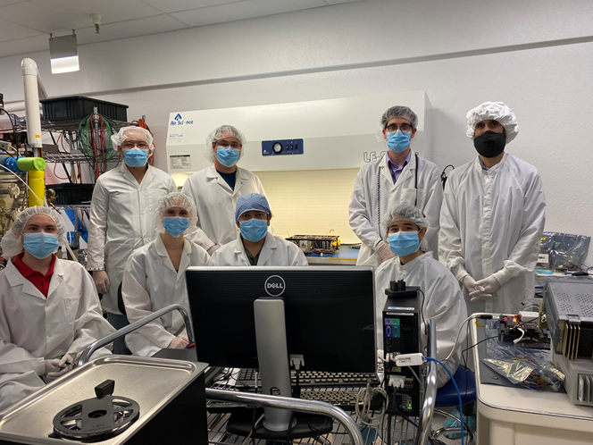
Acknowledgements
My mentor, Dr. Christopher Walker, and the amazing CatSat team!
University of Arizona, NASA Arizona Space Grant, FreeFall Aerospace, Rincon Research Corporation, Firefly Aerospace, NASA CubeSat Launch Initiative
Picture Credit: TaMya Reliford (2022)
Picture Credit: UA Communications (2022)

Slide 10
Thank You!

